Slide 1




Text Analiz Project
By
2022510013_Yasamin Valishariatpanahi
2022510046_Sara Mahyanbakhshayesh

Slide 2
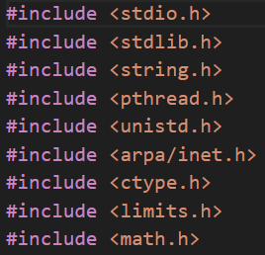
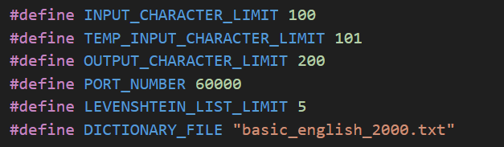
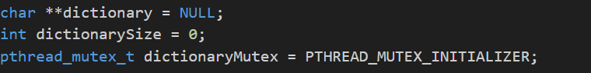
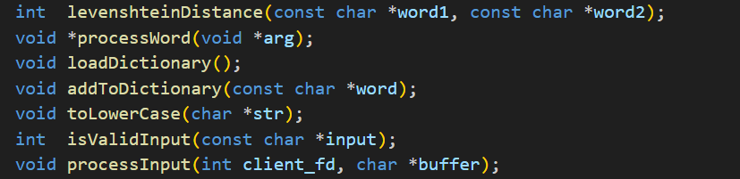
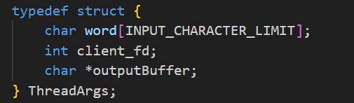
Libraries
Macros
variable declarations
mutex initialization
Struct
Function Declaration

Slide 3
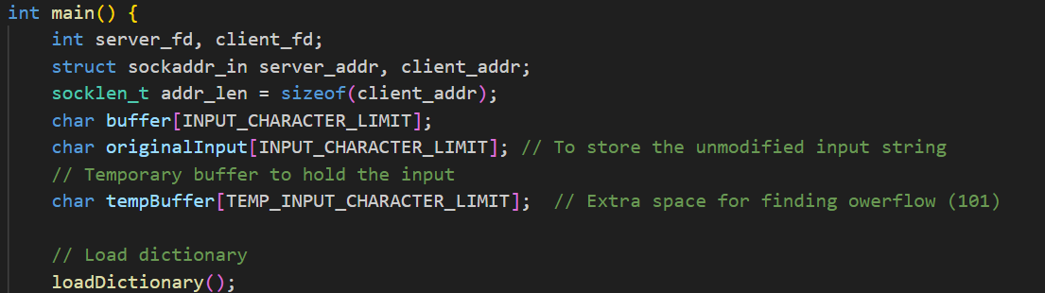
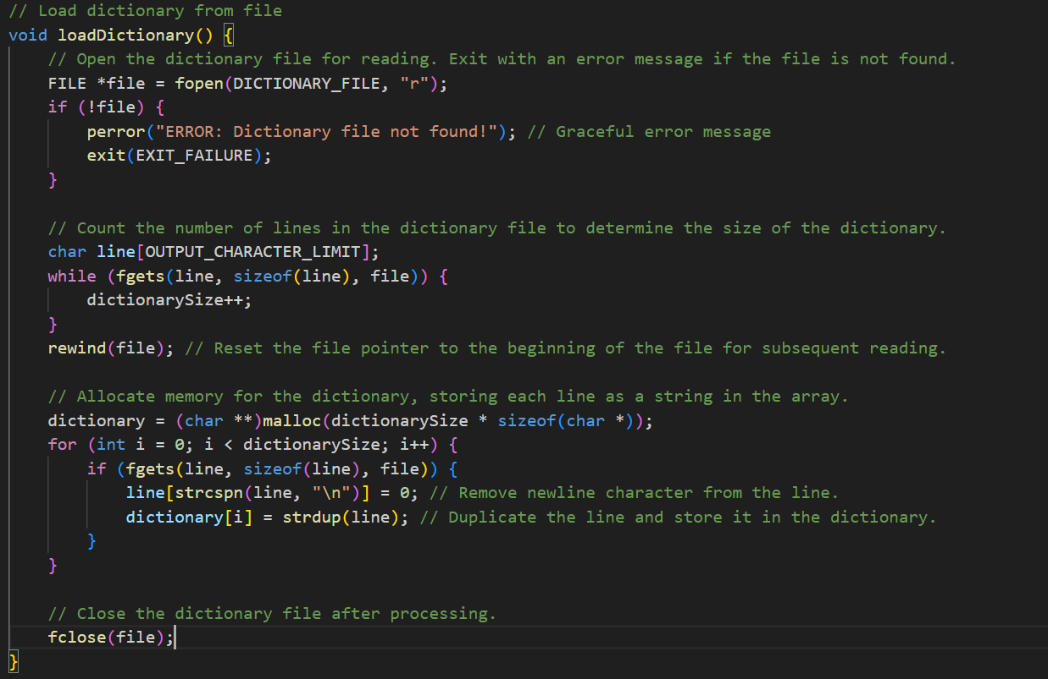
Main Function
Load Dictionary Function

Slide 4
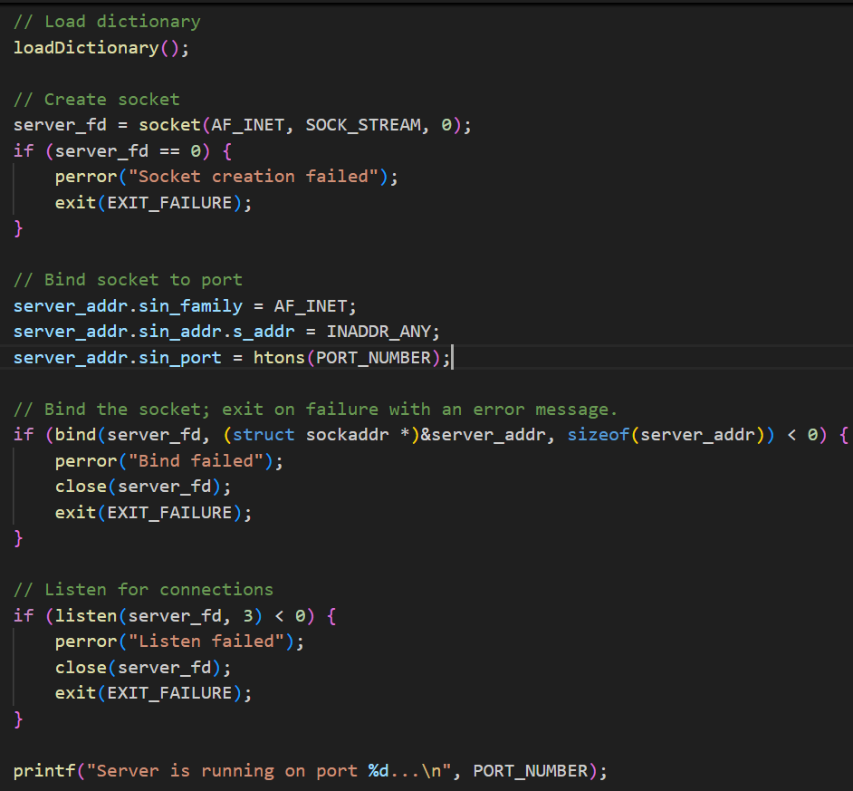
After Load Dictionary
in
main Function

Slide 5
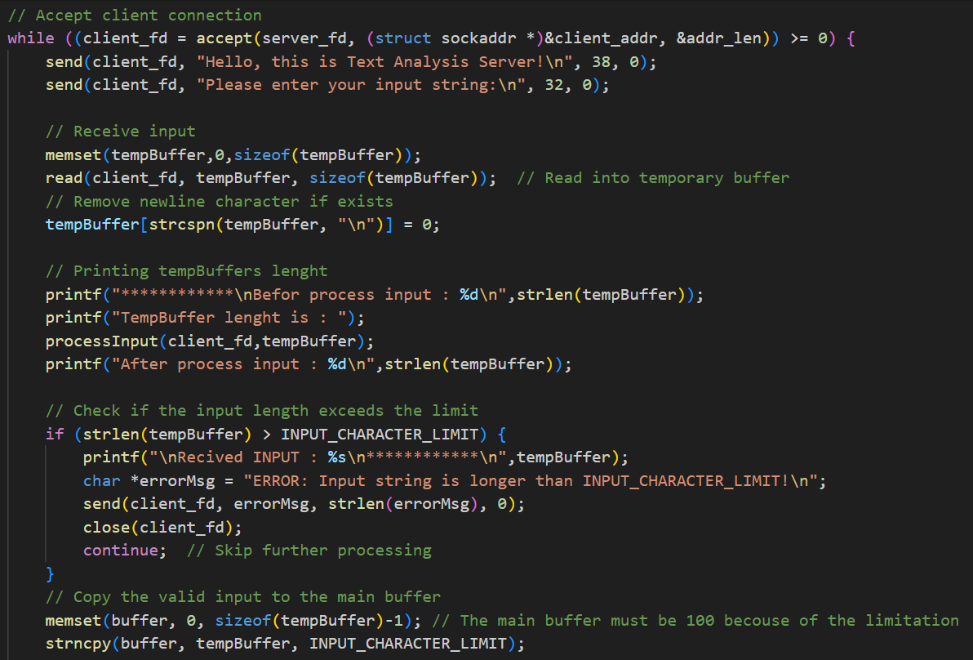
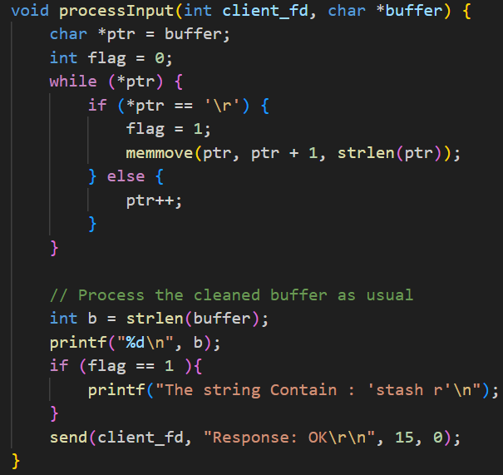
After printing port number & Accepting client connection in main function
While Starts
Getting input
Check Length
Remove “\r” from the
end of the input String
Copy TempBuffer to main Buffer

Slide 6
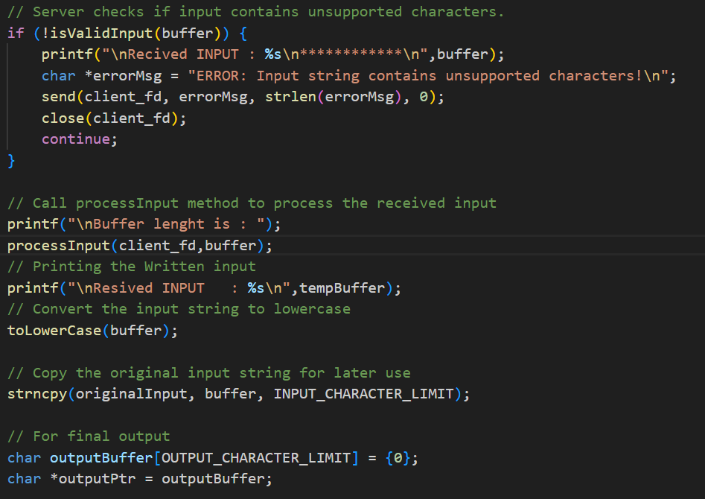
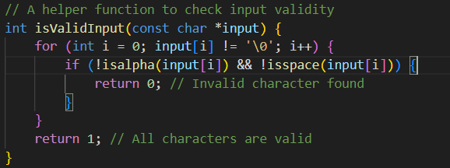
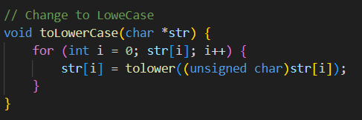
Inside While

Slide 7
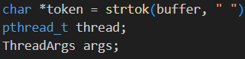
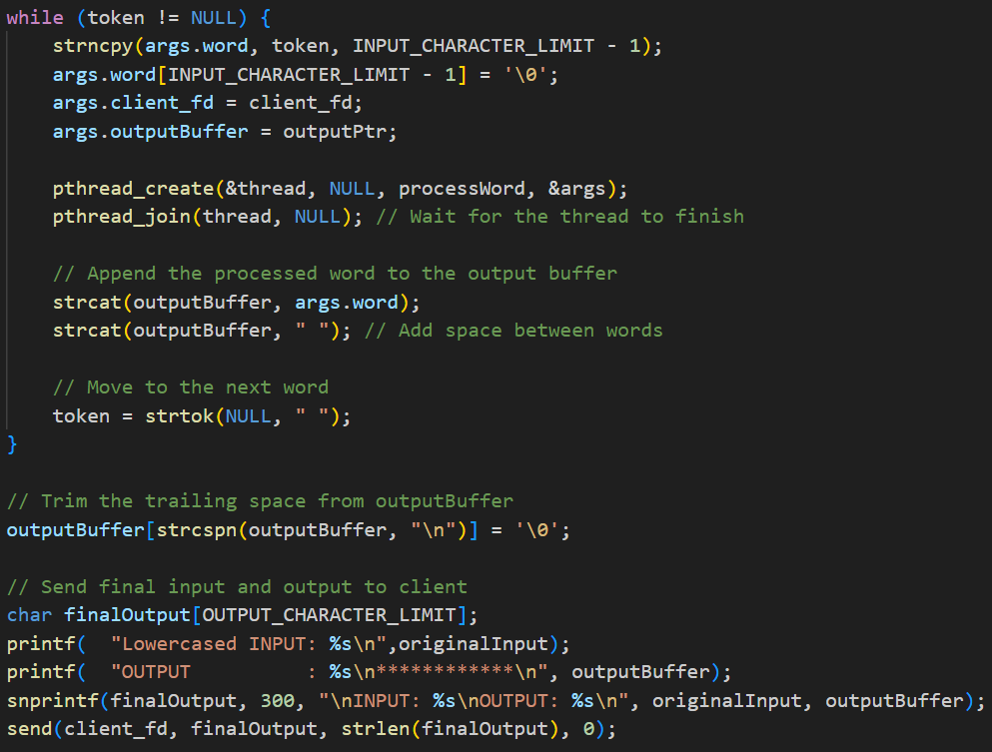
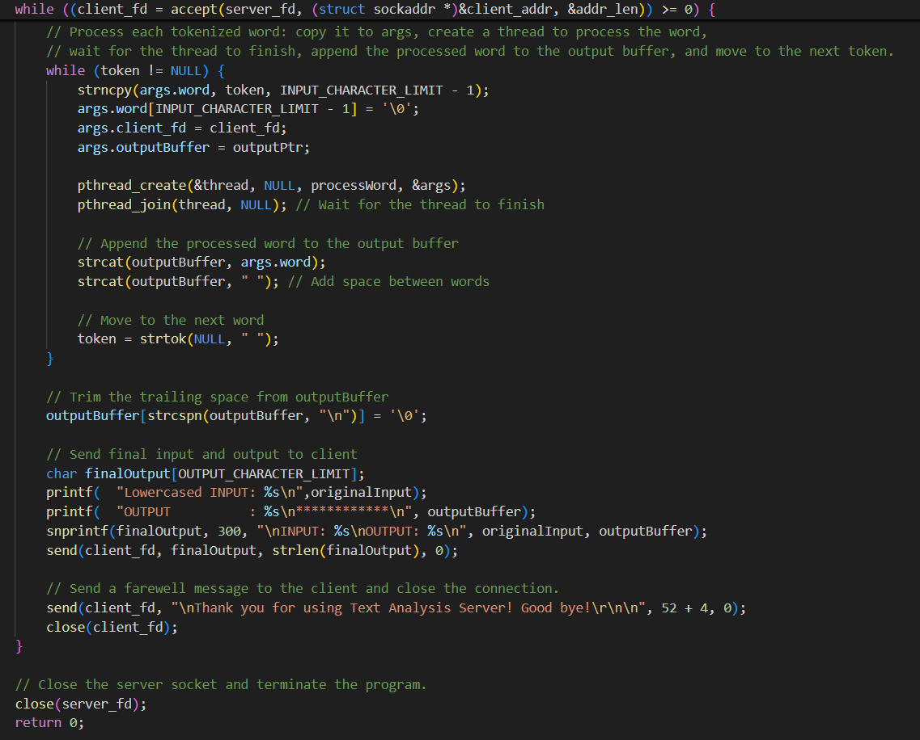
Inside While
Initializing
A Function
That Process a word
(thread function)
Will shown in Next Page
While Ends Here
Main Function Ends here

Slide 8
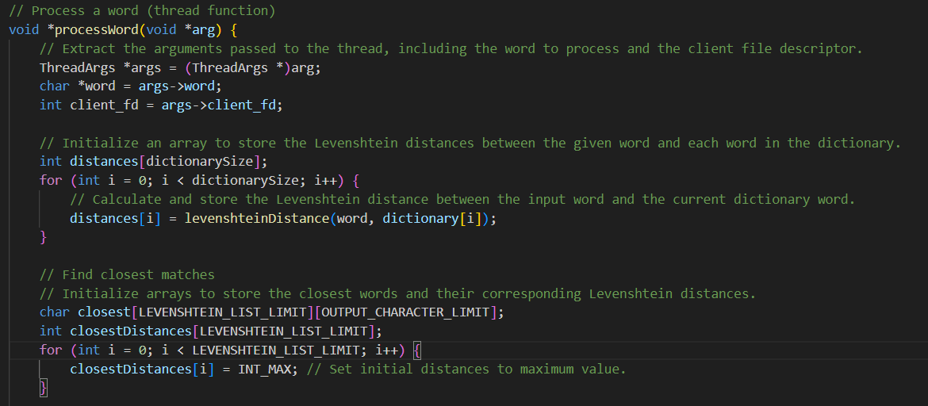
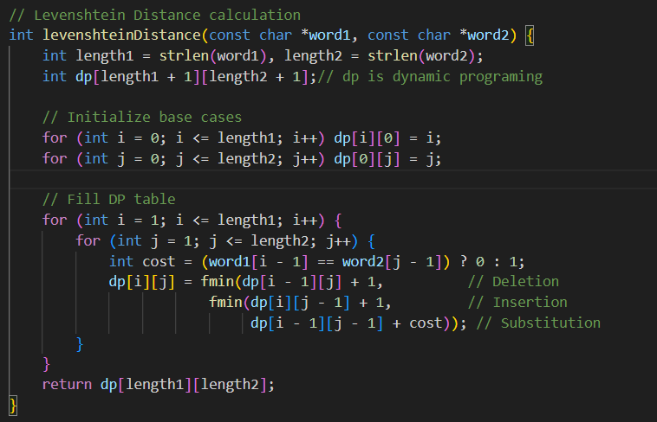
Continue
Continue

Slide 9
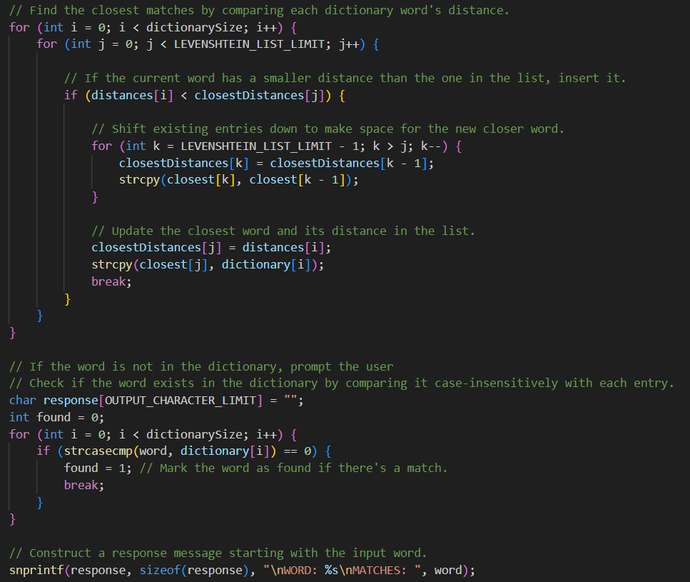
Continue

Slide 10
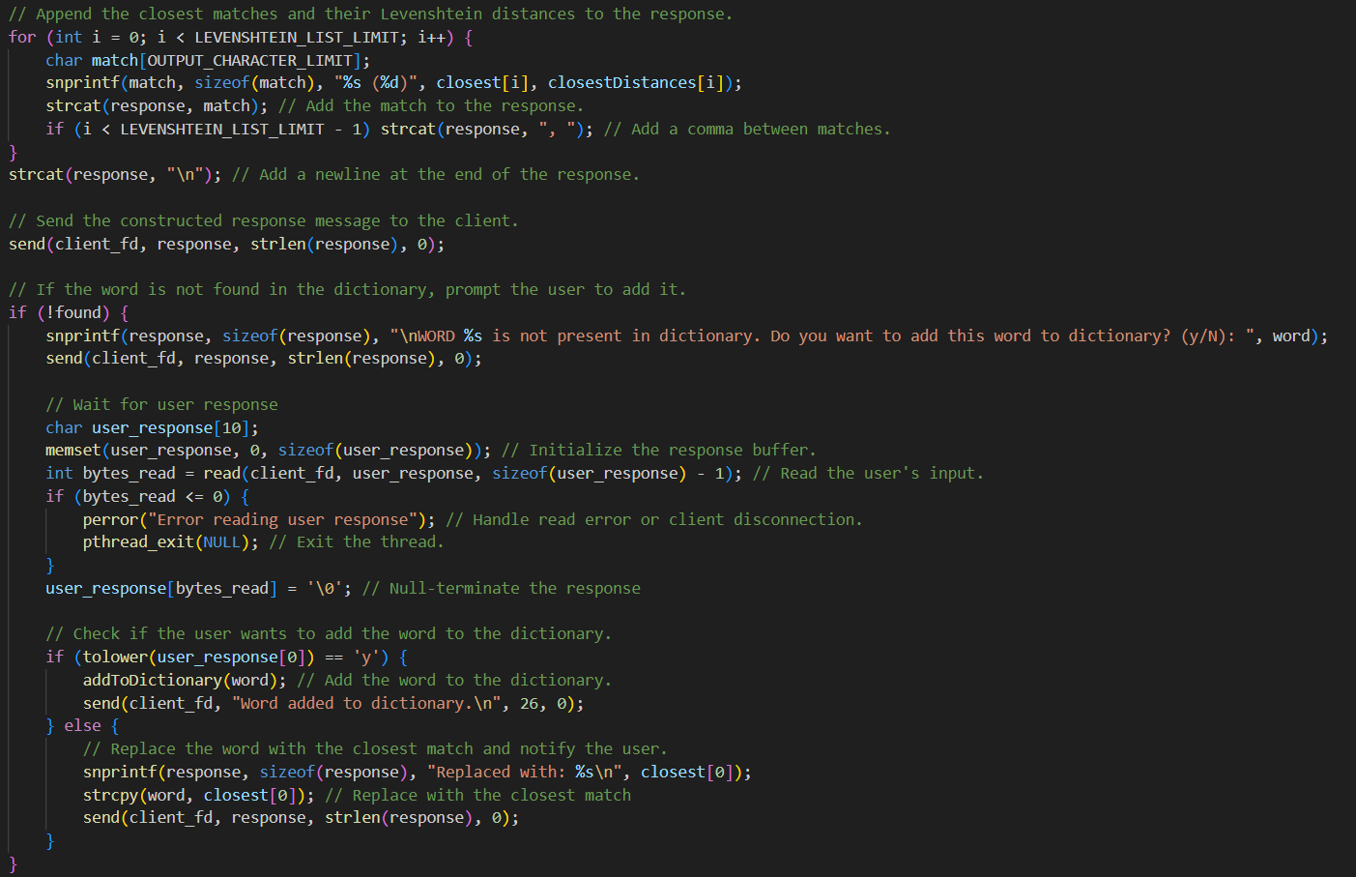
This Function Adds
the word to Dictionary
Code will Shown in Next Page
*ProcessWord Ends Here

Slide 11
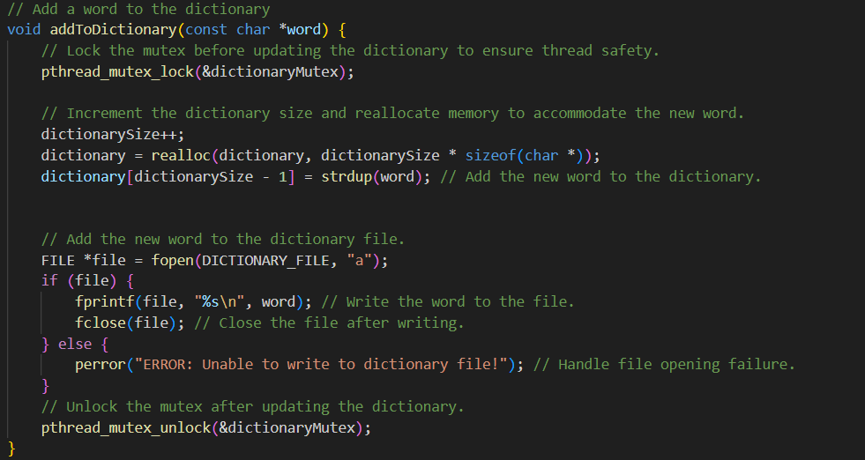
Add to dictionary part

Slide 12

Thanks
For
Watching

